Slide 1



The HUB 400: enterprise force multiplier

Slide 2

Cut capital costs.
Simplify IT management.
Minimize security threats.
Maximize technology ROI.
what we do
Notes:
A lot of questions around designing a 21st century classroom. There is no real standard for it yet

Slide 3

The World at Night
where we are (30+ countries)

Slide 4
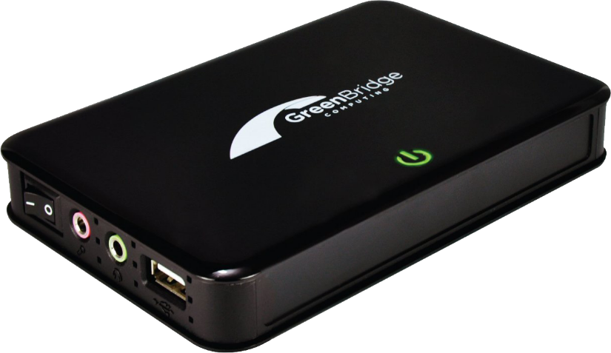
Introducing:
the world’s first $100 enterprise-class computing device.
Benefits:
70% budget savings
High-availability for maximum uptime
Centralized control, management, security
value proposition
Notes:
Our solution to this is Direct Virtualization…..

Slide 5
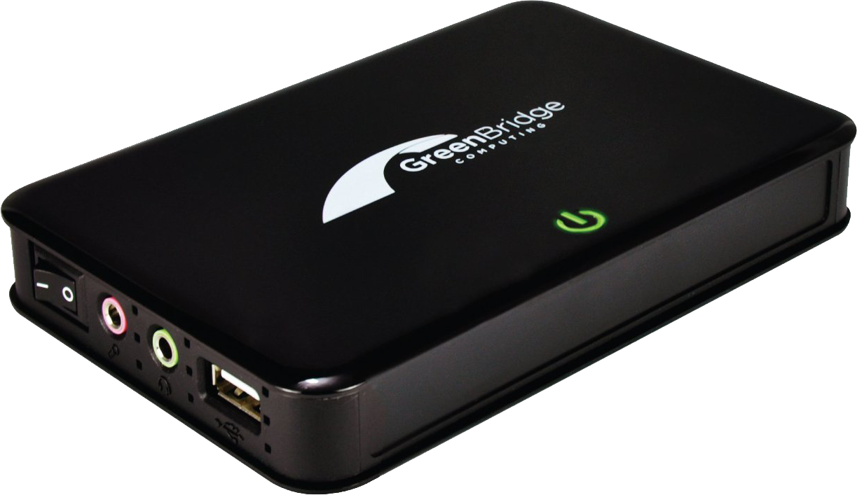
No moving parts.
No operating system.
90% reduced electricity.
Secure: reduced attack surface.
Gigabit Ethernet, USB over LAN.
Meet The HUB 400

Slide 6

Why would I want to turn 1 PC into 10?
The Market Today
I sell thin clients.
Market disruption:
$100 Windows computing
Solution/Value | PCs | Thin clients | GreenBridge
Performance
Maintenance
Cost
Notes:
Here is a snapshot of the market today:
You have HP, who just abandoned their MultiSeat solution. Simply, put: solutions like these cannibalize their business and they’d rather sell 10 computers than one.
On the other side, you have thin-client manufacturers who are happy to keep selling $200 and $300 devices

Slide 7
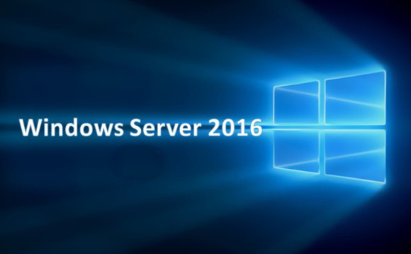
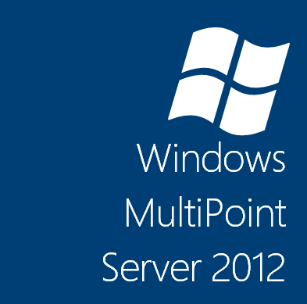

Seamless integration with Microsoft
Enterprise-class software

Slide 8
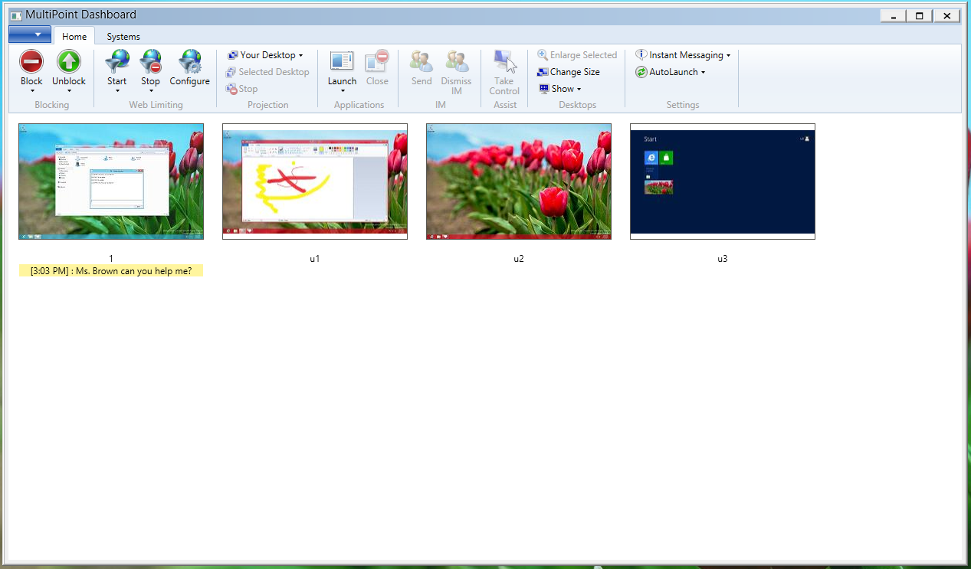

Human Resource Orchestration
Monitor and control desktops. Collaborate.
Key Features
Visibility & control over stations
Manage across devices: desktops, laptops, tablets
View real-time activity
Block stations
Project stations
Launch and close apps
Limit Web site browsing
Chat

Slide 9
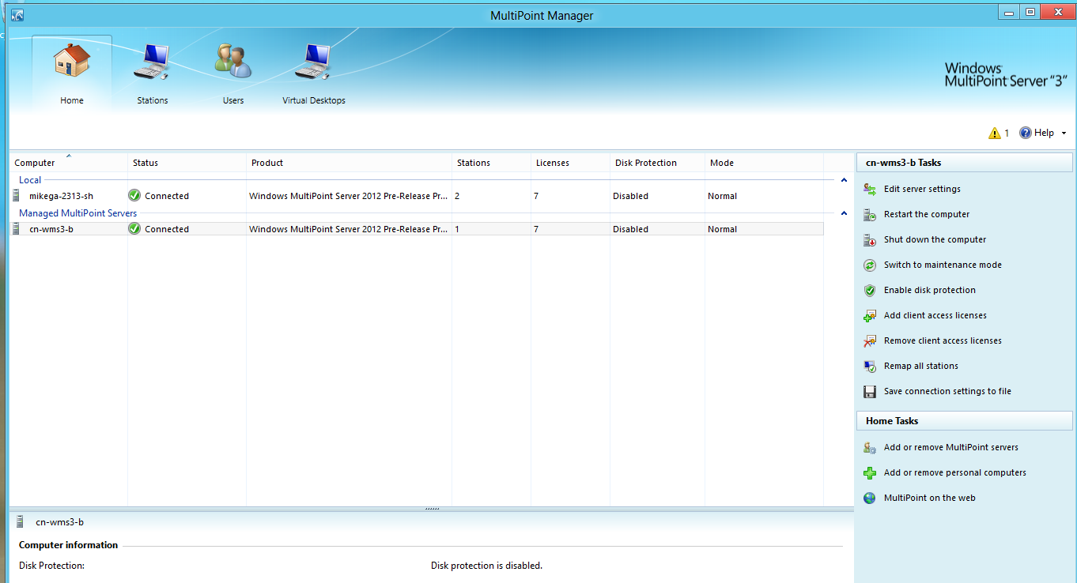
IT Administrator Management.
Simplified system administration across your network:
Key Features
Disk protection
Multi-machine management
VDI
Simplified licensing

Slide 10
TCO: 1,000 store rollout

Slide 11
“The HUB is a superb option for retail environments.”
Marty Ramos
CTO, Microsoft Retail Experience Center
Microsoft Retail Experience Center

Slide 12

App compat win vs.
Citrix + Vmware
Daimler Trucks North America
Notes:
One interesting story that validates this:

Slide 13
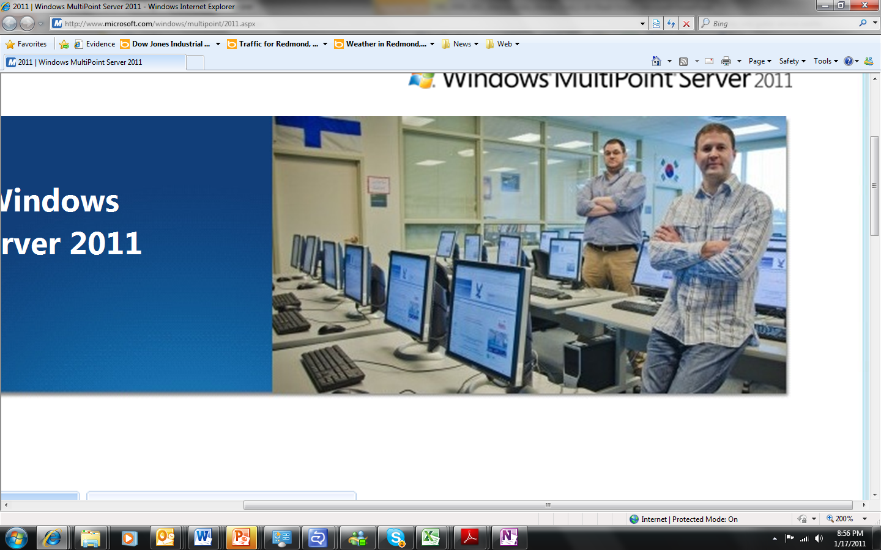
Bellevue School District, WA
$135K savings per school
>>
“We saved $135,000 [per school] on hardware by purchasing MultiPoint Servers instead of individual desktops. We looked at VMware and Citrix... We chose MultiPoint based on ease of use and cost savings.”
Jason Golec,
Manager of Network Operations, Bellevue School District (17,000 students)
Notes:
One interesting story that validates this:

Slide 14

85% savings (vs VDI)
Central Oregon Community College
Laura Boehme
Director, IT Infrastructure

Slide 15
“I am so glad we did not bite off on VDI; other schools have tried it and for the investment that was made, the gains did not come. $60K per classroom is not scalable. GreenBridge is scalable.”
Laura Boehme
Assistant Director of IT Infrastructure
Central Oregon Community College

Slide 16
“David’s deep understanding of market needs, extensive relationships, and passion for delighting our customers have resulted in a number of key customer wins.
GreenBridge has our full support…and is addressing a vastly underserved market.”
Chris Phillips
General Manager, Windows Server
Microsoft Corporation
Microsoft endorsement

Slide 17
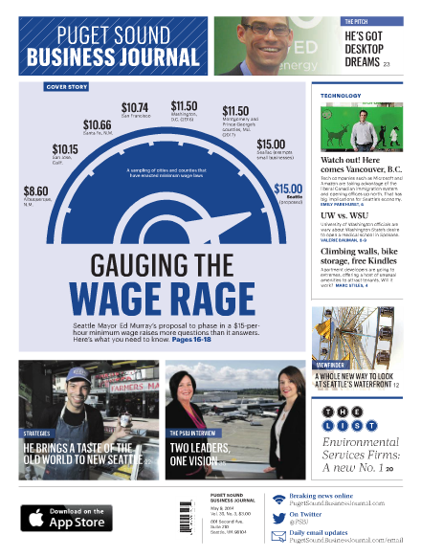
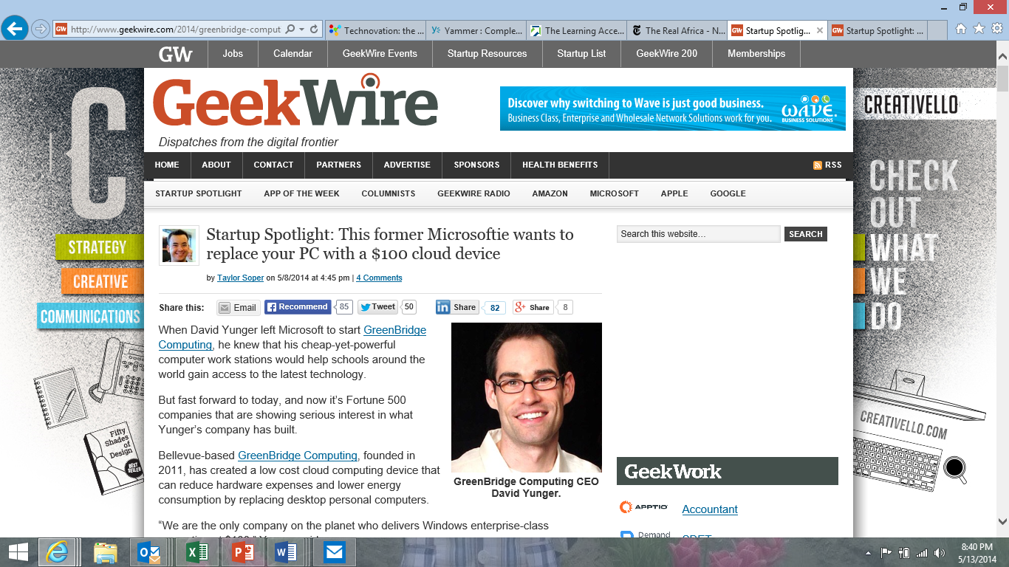

“This former Microsoftie wants to replace your PC with a $100 cloud device” -Geekwire
“The Pitch: GreenBridge bets big on desktops — with a new twist” Puget Sound Business Journal
In the Press

Slide 18
Next steps.

Slide 19

Stardate: 5999
(ubiquitous mobile computing… and Spock still prefers his workstation)

Slide 20
Built and serviced by the creators of MultiPoint
100,000s deployed devices
Decades of experience with Microsoft + cloud technologies
Market-leading insight integrating zero clients in enterprise environments
Backed by Microsoft:
Endorsed by Microsoft Retail Experience Center
Global alliance with Microsoft Technology Centers
Daily collaboration with Windows RDP / Windows Server engineering teams
Superior performance
Low cost
Run “private cloud” or on-prem
Exclusive supply agreements
Expertise
Relationships
Product
How we’re different
Notes:
Our solution to this is Direct Virtualization…..

